Slide 1
Village Plan - Background
The village first began to develop a Neighbourhood Plan
Can enable residents to have a say on housing development and is part of SODC Local Plan
Consultation:
Very few wanted big developments, Some wanted affordable housing
Neighborhood plan would not help in achieving these goals so we decided to move to the much broader Village Plan
The 2009 Village Plan was a success - Wanted to review it and develop new ideas
Village Plan Steering Ctte
Traffic & Parking
Open Spaces
Village Hall
Community
Diana Smith
Ben Riordan
Leslie Prater
Leslie Maynerd
Jean-Marc Grosfort
Keith Brooks
Community Emergency Plan
Conservation Area Assessment
Flooding & Drains
Pavilion
Editing: Sally Woolhouse & Katherine Higley
Many other people have contributed.
Much more help is needed
John Bradon
Jim Donahue
Rachel Hatcher
Will Barclay
Sarah Hanfrey
Neil Huntington+
Geoff Weir
Dave Bowen
John Southey
Robin Maccaw
Working groups now being set up
Peter Hawley
Laura Lucas

Slide 2
Timeline
Neighbourhood Plan
Village Plan
Decide Village Plan meets objectives better
NP Steering Committee Formed
Gather
Info
Set up working groups
Survey
views and ideas
Write
Draft Plan
Get
input
Final Plan
Nov 2016
Jan-Oct 2017
Jul-Dec 2017
Jan-May 2018
Jun-Sep 2018
Oct18 to Feb19
Mar-May 19
May
2019
Understand process
What happened in other villages experience?
Hold Village Consultation meetings
Set up survey
Analyse & publish results
Assess finances
Consult
Present to PC
Present to village
Start to implement
Redefine Working Groups
Have made improvements as we go (e.g. Village Hall)

Slide 3
Survey Results
Last summer we surveyed the everyone and 143 people/households responded:
Traffic - Congestion, parking and pedestrian safety biggest concern.
90% would support both a 20mph speed limit and parking restrictions to stop commuters parking all day
Village Hall. 75% of people thought improvements to the Village Hall were needed.
Village Green and Maze
People are very happy with this (the biggest item on the 2009 village plan).
90% of people would like the Maze area to remain an area for picnics and wildlife.
79% did not want to see further development of the Village Green. Of the 21% who did want some development, many suggested facilities for teenagers,
Fewer than 3% of want big facilities with hard finishes e.g BMX track / skate park.
There is a desire for better maintenance of the village environment.
People would like to see improvements to pavements and the highest priority was somehow to make the area outside the Ferryboat safer for pedestrians.
Additional community activities. Suggestions, such as a monthly community meal and various fitness activities will be followed up.
Detailed results on village website

Slide 4
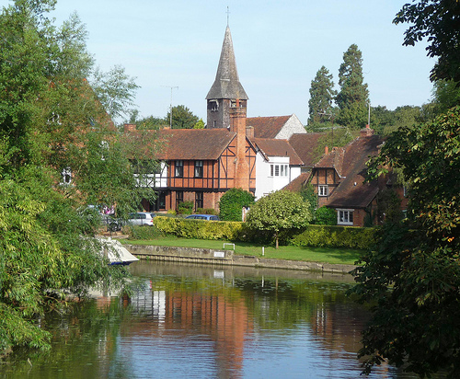
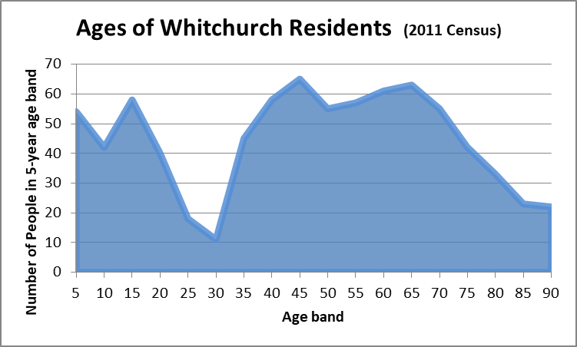
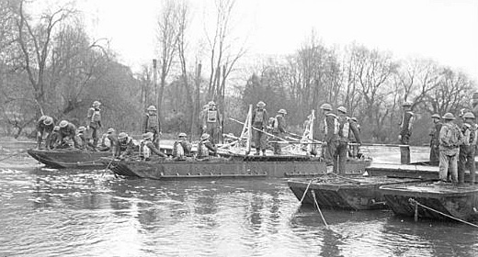
Other Data Gathering
Last 2009 Village Plan
Of the 22 proposed actions, 60% have been completed; perhaps the two most beneficial being the transfer of ownership to create the Village Green and improving the village website
Our detailed review is on the village website
Demographics
Age profile tells a story
Census: more mixed than you might think
Village History and Character
Never done a Conservation Area Assessment
Propose to start working on this with OCC

Slide 5
Recommendations
Manage parking better to improve traffic flow (without making parking more difficult for residents)
Improve road safety (20mph speed restriction, better arrangement at The Ferryboat)
Resurface pavements
Replace the Sports Pavilion
Upgrade the Village Hall
Develop maintenance plans for Open Spaces. Add no new facilities. Apply the good-practice guidelines
Complete and implement the Community Emergency Plan and the Flood Avoidance Plan
Help fund and complete a Conservation Area Assessment

Slide 6
Village Plan Recommendations with planned Parish Council contribution and coordinators
Ref. | Village Plan Recommendation | Continued from 2009 Plan? | Total Cost £ (incl. Grants/ Fundraising) | Parish Council Contribution £ (over 3 years) | Difficulty | Priority | Parish Council Lead - Working Group
Traffic and Parking Improvements:
VP-1 | Clear “no parking” sections as chicanes | 2009 | 12,000 | 12,000 | High | High | RH - TAPAG
VP-2 | A mandatory speed limit of 20mph | 2009 | 6,000 | 5,000 | High | High | RH - TAPAG
VP-3 | Restricted parking (e.g. Residents Only) |  | 5,000 | 5,000 | High | High | RH - TAPAG
VP-4 | Improve verges |  | 5,000 | 5,000 | High | High | RH - TAPAG
VP-5 | Create new parking bay |  | 5,000 | 5,000 | High | High | RH - TAPAG
Community Buildings:
VP-6 | Build New Pavilion |  | 208,370 | 28,370 | High | High | WB, JD - tea
VP-7 | Upgrade Village Hall | 2009 | 23,000 | 3,000 | High | High | KB - Hall Mgt Ctte, J-M G
Built Environment & pavements:
VP-8 | Raised pavement at Ferryboat | 2009 | 10,000 | 10,000 | Medium | High | TBA - PC
VP-9 | Resurface Hardwick Road pavements | 2009 | 15,400 | 11,300 | Low | Medium | TBA - PC
VP-10 | Manor Road pavement improvements | 2009 | 7,700 | 7,700 | Low | Medium | TBA - PC
VP-11 | Develop Community Emergency Plan |  | 2,000 | 0 | Low | Medium | JD - Emerg. Plan Group
VP-12 | Liaison person to maintain drains | 2009 | 0 | 0 | Medium | Medium | TBA
VP-13 | Hardwick Road Verges and Footpath | 2009 | 1,500 | 1,500 | Medium | Medium | TBA - WoTHABS
Open Space Improvements:
VP-14 | Develop plan for 9 open space areas |  |  |  | Low | Medium | TBA - Plan Owners
VP-15 | Polish Church Memorial Garden |  | 750 | 750 | Low | Medium | KB - SW+
VP-16 | Clean/ Repair Manor Road Play Area |  | 1,000 | 1,000 | Medium | Medium | KB + Volunteers
VP-17 | River Access improvements |  | 1,000 | 1,000 | Medium | Medium | TBA
VP-18 | Develop Conservation Area Assessment |  | 5,000 | 5,000 | Medium | Medium | TBA
Community initiatives:
VP-19 | Set up Green Team |  |  |  | Medium | Medium | TBA
VP-20 | Initiate Community Meal |  | 1,500 | 750 | Low | Medium | TBA
VP-21 | Encourage Netball, Thames Scullers, |  |  |  | Low | Medium | TBA
Total |  |  | 310,220 | 102,370

Slide 7
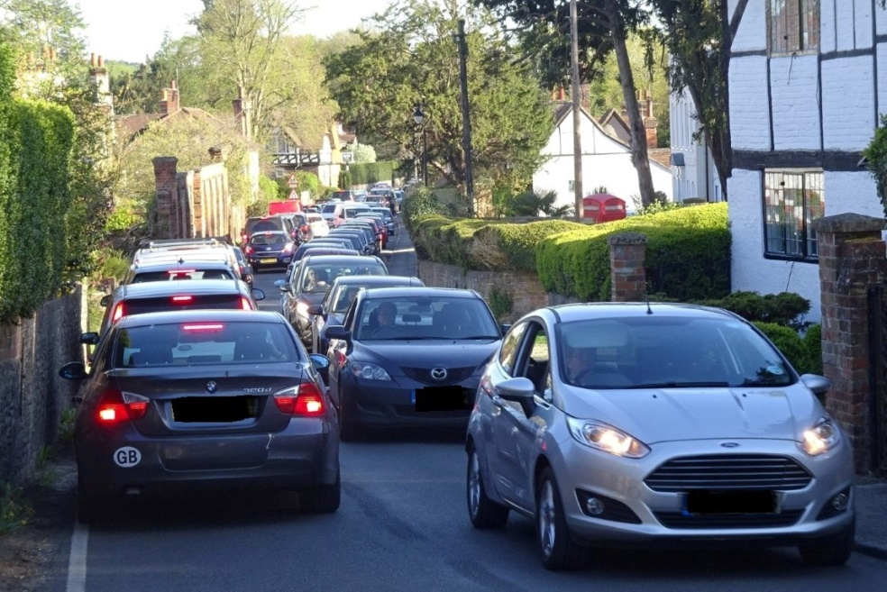
Traffic and Parking
At times, congestion in the High Street is severe.
Parked cars can slow down the traffic but irregular gaps block flow.
Parking not always available to residents.
Villagers have concerns for safety.
The TAPAG group have gather information, developed draft proposal and recently instructed a consultant to design these in more detail, working with Oxfordshire County Council.
Concern | Actual and Potential Action
TRAFFIC FLOW | Clear “no parking” sections of consistent lengths in key pinch points (e.g. entrance to narrows and by junctions like Eastfield Lane).
PARKING | Defined parking bays with restrictions (e.g. Residents only at certain times of the day )
SAFETY | 20mph speed limit, Aided by the parking bays creating chicanes. Consider the option raising the kerb at the ferryboat The Toll Bridge Company, have introduced a 20 mph speed limit. A working party cleared vegetation to make it possible to walk the whole length of Eastfield Lane on the verge
Other | Reinstate the verges (e.g. on the east side of the High Street )

Slide 8
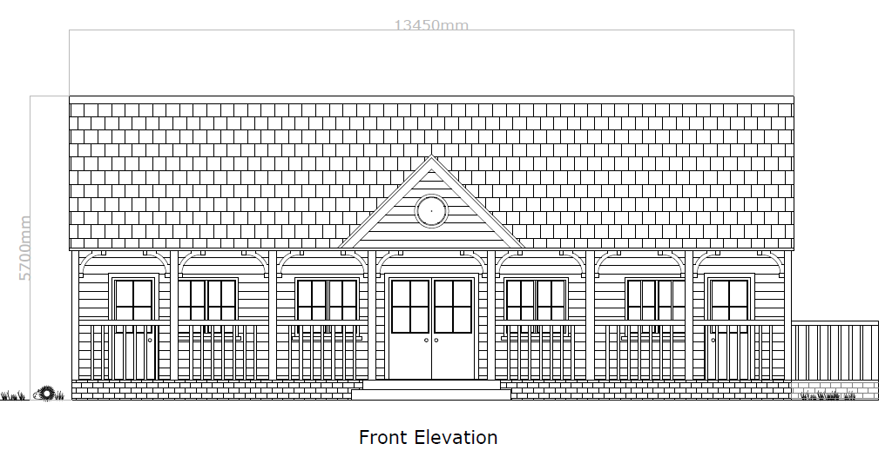
Pavilion
The existing Pavilion is beyond economical repair.
Have planning permission for a building with better facilities including showers.
Would like to expand to youth teams – could we start a netball team?
Need to raise £200k.
Grants and individual donations needed!

Slide 9
Village Hall
A detailed, costed, three-year upgrade plan has been prepared
Already the windows have been replaced, the hall painted (thanks to a team from Grant Thornton) and a 100-piece crockery set has been donated.
Further planned improvements include:
Clean and repair the roof, the electrics , sanitary facilities and partition wall
Upgrade the kitchen (this is the most costly item)
New flooring
Install phone & Wi-Fi
Cosmetic improvement including new stage curtains if funds permit
check the central heating system and potentially install a new boiler
Resurface car park and provide better dustbin storage
New notice boards and meeting material such as flip charts
Make a board showing the history of the hall from its initial use by the Canadian Air Force.
It will make the hall a really much more attractive but Jean-Marc Grosfort needs to raise another £20k to complete the planned work.
Individual donations will be needed as well as grants.

Slide 10
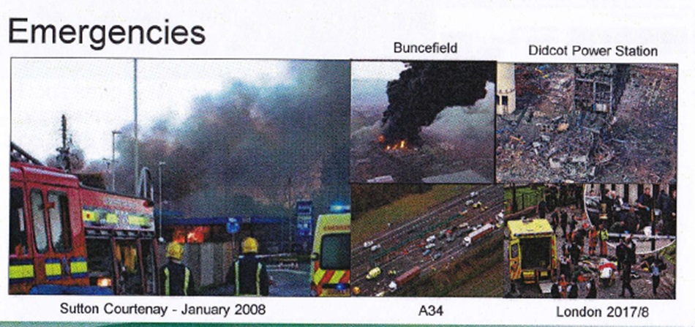
Community Emergency Plan
A small group have written a draft plan:
Includes contacts (shared with utilities, etc.), risks and mitigations (e.g. village hall as point of refuge)
8 actions to complete:
Help those needing support during power cuts to register
Further defibrillator training… …
As well, we need to plan to reduce flooding risk

Slide 11
What can I do to help?
Look at the draft plan on the village website and let us know what you think.
Contribute to fundraising for the Pavilion & Village Hall
Get/stay involved in the various working groups to complete the above actions
Join the Community Meal
Improve habitats (perhaps starting with your garden)
Support church, pubs, and village societies
Join the green team to look after our open spaces

